Slide 1
Compiler Construction
Lexical Analysis
Unit 2
Lexical Analysis Reading: Chapter 3
Deals with techniques for specifying and implementing lexical analyzer

Slide 2
Compiler Construction Lexical Analysis
Lexical Analyzer
Lexical Analyzer reads the source program character by character to produce tokens.
Normally a lexical analyzer doesn’t return a list of tokens at one shot, it returns a token when the parser asks a token from it.
Token
Source Program
Lexical Analyzer
Parser
Get next token
error
error
Symbol Table
Lexical analyzer may also perform other auxiliary operation like removing redundant white space, removing token separator (like semicolon) etc.
52

Slide 3
Compiler Construction Lexical Analysis
ISSUES OF LEXICAL ANALYZER
There are three issues in lexical analysis:
To make the design simpler.
To improve the efficiency of the compiler.
To enhance the computer portability.
3

Slide 4
Compiler Construction
Lexical Analysis
Tokens, Patterns, Lexemes
A token is a string of characters, categorized according to the rules as a symbol (e.g., IDENTIFIER, NUMBER, COMMA).
The process of forming tokens from an input stream of characters is called tokenization.
A token can look like anything that is useful for processing an input text stream or text file. Consider this expression in the C programming language: sum=3+2;
Lexeme | Token type
sum | Identifier
= | Assignment operator
3 | Number
+ | Addition operator
2 | Number
; | End of statement
52

Slide 5
Compiler Construction Lexical Analysis
Tokens, Patterns, Lexemes
Lexemes are the specific character strings that make up a token
For example: abc and 123
A token can represent more than one lexeme
Patterns are rules describing the set of lexemes belonging to a token
For example: “letter followed by letters and digits” and “non-empty sequence of digits”
Regular expressions are widely used to specify patterns
5

Slide 6
Compiler Construction Lexical Analysis
Attributes of Tokens
When a token represents more than one lexeme, lexical analyzer must provide additional information about the particular lexeme. This additional information is called as the attribute of the token.
For simplicity, a token may have a single attribute which holds the required information for that token.
For identifiers, this attribute a pointer to the symbol table, and the symbol table holds the actual attributes for that token.
Some attributes:
<id,attr>
<assgop,_>
<num,val>
where attr is pointer to the symbol table
no attribute is needed (if there is only one assignment operator) where val is the actual value of the number.
Example: dest = source + 5
Tokens: <id, pt for dest>, <assignop>, <num, 5>
Token type and its attribute uniquely identifies a lexeme.
52

Slide 7
Compiler Construction Lexical Analysis
Lexical Analyzer implementation strategies
Use a lexical-analyzer generator like flex to produce lexical analyzer from a regular express based specification. The generator provides routines for reading and buffering the input.
Design a lexical analyzer in high level programming language like C, using the I/O facilities of the language to read and buffering the input.
Write the lexical analyzer in assembly language and explicitly manage the input and buffering
The above are in increasing order of complexity and efficiency
52

Slide 8
Compiler Construction Lexical Analysis
Error Recovery Strategies in Lexical Analysis
The following are the error-recovery actions in lexical analysis:
1) Deleting an extraneous character.
2) Inserting a missing character.
3) Replacing an incorrect character by a correct character.
4) Transforming two adjacent characters.
5) Panic mode recovery: Deletion of successive characters from the token until error is resolved
8

Slide 9
Compiler Construction
Lexical Analysis
Lookahead and Buffering
Many times, a scanner has to look ahead several characters from the current character in order to recognize the token.
For example int is keyword in C, while the term inp may be a variable name. When the character ‘i’ is encountered, the scanner can not decide whether it is a keyword or a variable name until it reads two more characters.
In order to efficiently move back and forth in the input stream, input buffering is used
52

Slide 10
Compiler Construction
Lexical Analysis
Input Buffering
We often have to look one or more characters beyond the next lexeme before we can be sure we have the right lexeme. As characters are read from left to right, each character is stored in the buffer to form a meaningful token as shown below:
We introduce a two-buffer scheme that handles large look aheads safely. We then consider an improvement involving "sentinels" that saves time checking for the ends of buffers.
52

Slide 11
Buffer Pairs
A buffer is divided into two N-character halves, as shown below
Each buffer is of the same size N, and N is usually the number of characters on one disk block. E.g., 1024 or 4096 bytes.
Using one system read command we can read N characters into a buffer.
If fewer than N characters remain in the input file, then a special character, represented by eof, marks the end of the source file.
Two pointers to the input are maintained:
1. Pointer lexeme_beginning, marks the beginning of the current lexeme, whose extent we are attempting to determine.
2. Pointer forward scans ahead until a pattern match is found.
Once the next lexeme is determined, forward is set to the character at its right end.
The string of characters between the two pointers is the current lexeme.
After the lexeme is recorded as an attribute value of a token returned to the parser, lexeme_beginning is set to the character immediately after the lexeme just found.
11

Slide 12
Advancing forward pointer:
Advancing forward pointer requires that we first test whether we have reached the end of one of the buffers, and if so, we must reload the other buffer from the input, and move forward to the beginning of the newly loaded buffer. If the end of second buffer is reached, we must again reload the first buffer with input and the pointer wraps to the beginning of the buffer.
Code to advance forward pointer:
if forward at end of first half then begin
reload second half;
forward := forward + 1
end
else if forward at end of second half then begin
reload second half;
move forward to beginning of first half
end
else forward := forward + 1;
Fgfgfg fgdffgdfj =
A + B; printf(“dkffj”);
12

Slide 13
Using Sentinels
For each character read, we make two tests: one for the end of the buffer, and one to determine what character is read. We can combine the buffer-end test with the test for the current character if we extend each buffer to hold a sentinel character at the end.
The sentinel is a special character that cannot be part of the source program, and a natural choice is the character eof.
The sentinel arrangement is as shown below:
Note that eof retains its use as a marker for the end of the entire input. Any eof that appears other than at the end of a buffer means that the input is at an end.
13

Slide 14
Using Sentinels
Code to advance forward pointer
forward : = forward + 1;
if forward ↑ = eof then begin
if forward at end of first half then begin
reload second half;
forward := forward + 1
end
else if forward at end of second half then begin
reload first half;
move forward to beginning of first half end
else /* eof within a buffer signifying end of input */
terminate lexical analysis
end
14

Slide 15
Compiler Construction
Lexical Analysis
Specification of Tokens
Stings & Languages
An alphabet Σ is a finite set of symbols (characters) A string s is a finite sequence of symbols from Σ
|s| denotes the length of string s
ε denotes the empty string, thus |ε| = 0 Operators on Strings:
Concatenation: xy represents the concatenation of strings x and y.
s ε = ε s = s
_{s}0
- s^{n} = s s s .. s ( n times) = ε
A language is a specific set of strings over some fixed alphabet Σ
∅ the empty set is a language.
{ε} the set containing empty string is a language
The set of well-formed C programs is a language
The set of all possible identifiers is a language.
52

Slide 16
Compiler Construction
Lexical Analysis
Specification of Tokens
Operation on Languages
Concatenation: L₁L₂ = { s₁s₂ | s₁ ∈ L₁ and s₂ ∈ L₂ } Union: L₁ ∪ L₂ = { s | s ∈ L₁ or s ∈ L₂ }
Exponentiation: L⁰ = {ε} L¹ = L
Kleene Closure: L* = ∪_{i=0,…,∞} L^{i} Positive Closure: L⁺ = ∪_{i=1,…,∞} L^{i}
L² = LL
52

Slide 17
Compiler Construction
Lexical Analysis
Specification of Tokens
Operation on Languages: Example
L₁ = {a,b,c,d} L₂ = {1,2}
L₁L₂ = {a1,a2,b1,b2,c1,c2,d1,d2} L₁ ∪ L₂ = {a,b,c,d,1,2}
L₁³= all strings with length three (using a,b,c,d}
L₁ = all strings using letters a,b,c,d and empty string
*
L₁⁺ = doesn’t include the empty string
52

Slide 18
Compiler Construction
Lexical Analysis
Specification of Tokens
Regular Expressions
We use regular expressions to describe tokens of a programming language.
Basis symbols:
ε is a regular expression denoting language {ε}
a ∈ Σ is a regular expression denoting {a}
If r and s are regular expressions denoting languages L₁(r) and L₂(s)
respectively, then
r+s is a regular expression denoting L₁ (r) ∪ L₂(s)
rs is a regular expression denoting L₁ (r) L₂(s)
r* is a regular expression denoting (L₁ (r))*
(r) is a regular expression denoting L₁ (r)
A language defined by a regular expression is called a regular set
<number>

Slide 19
Compiler Construction
Lexical Analysis
Specification of Tokens
Properties of Regular Expressions
For regular expression r, s & t
r + s = s + r
r + (s + t) = (r + s) + t (rs)t = r(st)
r (s + t) = rs + rt
εr = r= rε r** = r*
(union is commutative)
(union is associative) (concatenation is associative)
(concatenation distributes over union)
(ε is the identity element for concatenation) (closure is idempotent)
<number>

Slide 20
Compiler Construction
Lexical Analysis
Specification of Tokens Regular Expressions: Examples
Given the alphabet A = {0,1}
1(1+0)*0 denotes the language of all string that begins with a 1 and ends with a 0
(1+0)*00 denotes the language of all strings that ends with 00 (binary number multiple of 4)
(01)*+(10)* denotes the set of all stings that describe alternating 1s and 0s
<number>

Slide 21
Compiler Construction Lexical Analysis
Regular Expressions: Exercise Review
Given the alphabet A = {0,1} write the regular expression for the following
String that either have substring 001 or 100
Strings where no two 1s occurs consecutively
String which have an odd numbers of 0s
String which have an odd numbers of 0s and an even numbers 1s
String that have at most 2 0s
String that at least 3 1s
Strings that have at most two 0s and at least three 1s
(0+1)*001 (0+1)*+ (0+1)* 100 (0+1)*
Valid string: 0, 01,10,010,001,01001
Invalid string: 11, 011,110,
(0+€)*(1+€)0*)*
<number>

Slide 22
Compiler Construction
Lexical Analysis
Specification of Tokens
Regular Definitions
To write regular expression for some languages can be difficult, because their regular expressions can be quite complex. In those cases, we may use regular definitions.
We can give names to regular expressions, and we can use these names as symbols to define other regular expressions.
A regular definition is a sequence of the definitions of the form:
d₁ → d₂ → | r₁ r₂ | where d_{i} is a distinct name and r_{i} is a regular expression over symbols in
. |  | Σ∪{d₁,d₂,...,d_{i-1}}
d_{n} → | r_{n} | basic symbols previously defined names
<number>

Slide 23
Compiler Construction
Lexical Analysis
Specification of Tokens
Regular Definitions: Examples
Identifiers in Pascal are defined as a string of letters and digits beginning with a letter
letter → A | B | ... | Z | a | b | ... | z digit → 0 | 1 | ... | 9
id → letter (letter | digit ) *
If we try to write the regular expression representing identifiers without using regular definitions, that regular expression will be complex.
(A|...|Z|a|...|z) ( (A|...|Z|a|...|z) | (0|...|9) ) *
Regular definitions are not recursive:
digits → digit digits|digit wrong!
<number>

Slide 24
Compiler Construction
Lexical Analysis
Specification of Tokens
Notational Shorthand
The following shorthands are often used:
r⁺ = rr* r? = r|ε
[a-z] = a|b|c|…|z
Examples:
digit → [0-9]
num → digit⁺ (. digit⁺)? ( E (+|-)? digit⁺ )?
<number>

Slide 25
Compiler Construction Lexical Analysis
Regular Definitions: Exercise Review
Write regular definition for specifying floating point number in a programming language like C
Write regular definitions for specifying an integer array declaration in language like C
<number>

Slide 26
Compiler Construction Lexical Analysis
Recognition of Tokens
A recognizer for a language is a program that takes a string x, and answers “yes” if x is a sentence of that language, and “no” otherwise.
Recognition of token implies implementing a regular expression recognizer. That entails the implementation of Finite Automation
A finite automaton can be: deterministic (DFA) or non-deterministic (NFA)
This means that we may use a deterministic or non-deterministic automaton as a lexical analyzer.
Both deterministic and non-deterministic finite automaton recognize regular sets. Which one?
deterministic – faster recognizer, but it may take more space
non-deterministic – slower, but it may take less space
Deterministic automatons are widely used lexical analyzers.
<number>

Slide 27
Compiler Construction Lexical Analysis
Recognition of Tokens
Design of a Lexical Analyzer
First, we define regular expressions for tokens; Then we convert them into a DFA to get a lexical analyzer for our tokens.
Algorithm1:
Regular Expression → NFA → DFA (two steps: first to NFA, then to DFA )
Algorithm2:
Regular Expression →DFA
(directly convert a regular expression into a DFA)
Optional
regular expressions
NFA
DFA
Simulate NFA to recognize tokens
Simulate DFA to recognize tokens
<number>

Slide 28
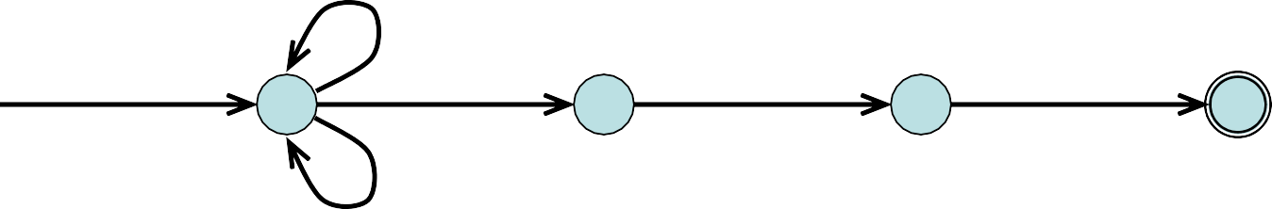
Compiler Construction Lexical Analysis
Non-Deterministic Finite Automaton (NFA)
An NFA is a 5-tuple (S, Σ, δ, s₀, F) where
S is a finite set of states
Σ is a finite set of symbols, the alphabet
δ is a mapping from S × Σ to a set of states
s₀ ∈ S is the start state
F ⊆ S is the set of accepting (or final) states
A NFA accepts a string x, if and only if there is a path from the starting state to one of accepting states such that edge labels along this path spell out x.
a
S = {0,1,2,3}
Σ = {a,b}
s₀ = 0
F = {3}
start
0
a
1
b
2
b
3
b
The above state machine is an NFA for regular expression (a+b)*abb having non deterministic transition at the state 0. On reading a it may either stay at state 0 or go to state 1.
<number>

Slide 29
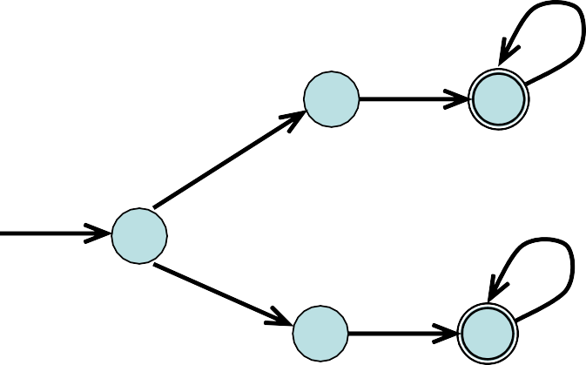
Compiler Construction Lexical Analysis
ε- NFA
ε- transitions are allowed in NFAs. In other words, we can move from one state to another one without consuming any symbol.
a
1
a
2
ε
Regular expressions are easily convertible ε -NFA
start
b
0
ε
3 4
b
The figure shows a state machine with ε moves that is equivalent to the regular expression aa* +bb*. The upper half of the state machine recognize aa* and lower half recognize bb*. The machine non-deterministically move to the upper half or lower half when started from state 0
<number>

Slide 30
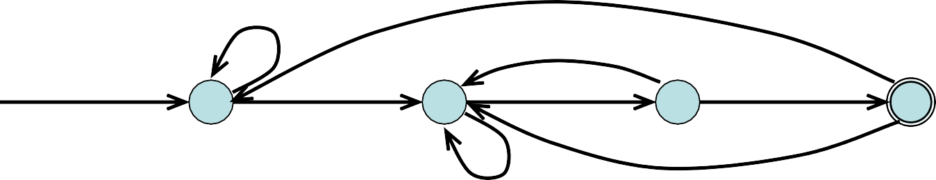
Compiler Construction Lexical Analysis
Deterministic Finite Automaton (DFA)
A deterministic finite automaton is a special case of an NFA
No state has an ε-transition
For each state s and input symbol a there is at most one edge labeled a leaving si.e. transition function is from pair of state-symbol to state (not set of states)
b
a b
b
start
0
a
1
2
b
3
a
a
The above figure shows DFA for the same regular expression (a+b)*abb
<number>

Slide 31
Compiler Construction Lexical Analysis
Implementing a DFA
Input: An input string x, assume that the end of a string is marked with a special symbol (say eos).
Output: returns “yes” if the input string is accepted, else return “no”
s ← s₀
c ← nextchar
while (c != eos) do
begin
s ←move(s,c)
c ← nextchar
end
if (s in F) then
return “yes”
else
return “no”
{ start from the initial state }
{ get the next character from the input string }
{ do until the end of the string }
{ transition function }
{ if s is an accepting state }
(an efficient implementation)
<number>

Slide 32
Compiler Construction
Lexical Analysis
Implementing a NFA
S ← ε-closure({s₀}) c ← nextchar
while (c != eos) { begin
{ set all of states can be accessible from s₀ by ε-transitions }
s ← ε-closure(move(S,c))
c← nextchar
{ set of all states can be accessible from a state in S by a transition on c }
end
if (S∩F != Φ) then return “yes”
else
return “no”
{ if S contains an accepting state }
<number>

Slide 33
Compiler Construction Lexical Analysis
Conversion: Regular Expression to NFA Thomson’s Construction
This is one way to convert a regular expression into a NFA.
There can be other ways (much efficient) for the conversion.
Thomson’s Construction is simple and systematic method.
It guarantees that the resulting NFA will have exactly one final state, and one start state.
Construction starts from simplest parts (alphabet symbols).
To create a NFA for a complex regular expression, NFAs of its sub- expressions are combined to create its NFA,
<number>

Slide 34
Compiler Construction
Lexical Analysis
RE to NFA Thomson’s Construction
i
ε
f
1. To recognize an empty string ε
2. To recognize a symbol a in the alphabet Σ
i
a
f
If N(r₁) and N(r₂) are NFAs for regular expressions r₁ and r₂
a. For regular expression r₁ + r₂
ε
ε
N(r₁)
ε
N(r₁ + r₂)
i
f
ε
N(r₂)
<number>

Slide 35
Compiler Construction
Lexical Analysis
RE to NFA
Thomson’s Construction
b. For regular expression r₁ r₂
The start state of N(r₁) becomes the start state of N(r₁r₂) and final state of N(r₂) become final state of N(r₁r₂)
i N(r )
N(r )
f
1
2
N(r₁ r₂)
c. For regular expression r*
ε
ε ε
i
N(r) f
ε
N (r*)
Using rule 1 and 2 we construct NFA’s for each basic symbol in the expression, we
combine these basic NFA using rule 3 to obtain the NFA for entire expression
<number>

Slide 36
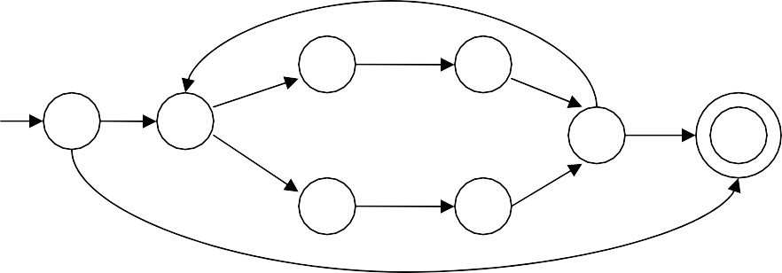
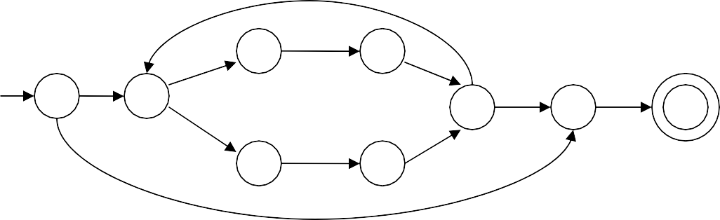
Compiler Construction
RE to NFA
Lexical Analysis
Thomson’s Construction
Example:- NFA construction of RE (a+b) * a
a
a:
a
ε
ε
ε
(a + b)
b
b
ε
b:
ε
ε
ε
a
ε
(a + b) *
ε
ε
b
ε
ε
ε
a
ε
ε
ε
(a+b) * a
ε
ε
a
b
ε
ε
<number>

Slide 37
Compiler Construction Lexical Analysis
Conversion from NFA to DFA subset Construction
The subset construction algorithm converts an NFA into a DFA We use the following operations to keep the track of sets of NFA
ε-closure(s) => the set of NFA states reachable from state s on ε- transition i.e. {s} ∪ {t | s →ε … →ε t}
ε-closure(T) => the set of NFA states reachable from state s in T on ε- transition i.e ∪_{s∈T} ε-closure(s)
move(T,a) =>
the set of NFA states to which there is transition on input a from state s in T i.e. {t | s →_{a} t and s ∈ T}
The algorithm produces:
Dstates is the set of states of the new DFA consisting of sets of states of the NFA
Dtran is the transition table of the new DFA
<number>

Slide 38
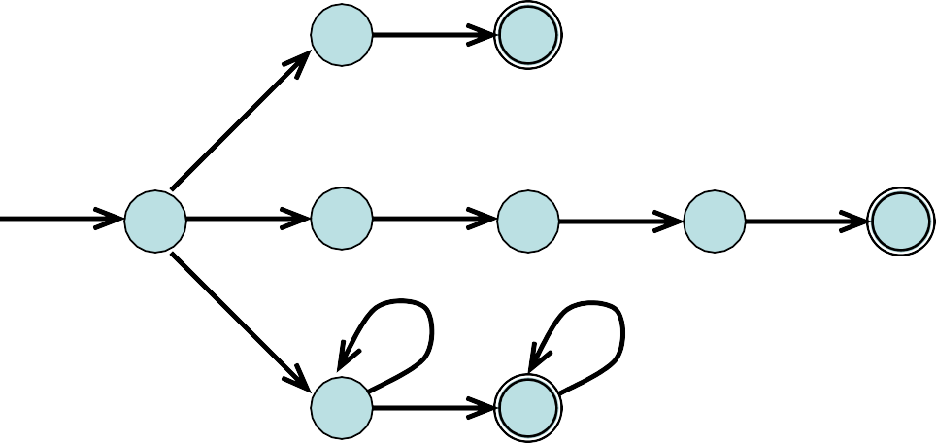
Compiler Construction Lexical Analysis
Conversion from NFA to DFA subset Construction
ε-closure and move Examples
ε-closure({0}) = {0,1,3,7}
a
move({0,1,3,7},a) = {2,4,7}
ε-closure({2,4,7}) = {2,4,7}
move({2,4,7},a) = {7}
ε-closure({7}) = {7}
move({7},b) = {8}
ε-closure({8}) = {8}
move({8},a) = ∅
1 2
ε
ε
ε
start
a a
b b
b
0
3
4
5
6
7
b
8
a
a
b
a
none
0
1
3
7
2
4
7
7
8
<number>

Slide 39
Compiler Construction Lexical Analysis
Conversion from NFA to DFA subset Construction Algorithm
put ε-closure(s₀) as an unmarked state in to Dstates
while there is an unmarked state T in Dstates do
mark T
for each input symbol a ∈ Σ do U = ε-closure(move(T,a)) if U is not in Dstates then
add U as an unmarked state to Dstates
end if
Dtran[T,a] = U
end do end do
A state of Dstates is an accepting state of DFA if it is a set of NFA states containing at least one accepting state of NFA
The start state of DFA is ε-closure(s₀)
<number>

Slide 40

Compiler Construction Lexical Analysis
Conversion from NFA to DFA subset Construction Example
a
ε
ε
2 3 ε
0
ε
1
6
ε
7
a
8
b
ε
ε
4
5
S₀ = ε-closure({0}) = {0,1,2,4,7}
⇓ mark S₀
ε-closure(move(S₀,a)) = ε-closure({3,8}) = {1,2,3,4,6,7,8} = S₁
ε-closure(move(S₀,b)) = ε-closure({5}) = {1,2,4,5,6,7} = S₂
S₀ into Dstates as an unmarked state
S₁ into Dstates
S₂ into Dstates
Dtran[S₀,a] ← S₁
Dtran[S₀,b] ← S₂
⇓ mark S₁
ε-closure(move(S₁,a)) = ε-closure({3,8}) = {1,2,3,4,6,7,8} = S₁
ε-closure(move(S₁,b)) = ε-closure({5}) = {1,2,4,5,6,7} = S₂
Dtran [S₁,a] ← S₁ Dtran [S₁,b] ← S₂
⇓ mark S₂
33

Slide 41
Compiler Construction Lexical Analysis
Conversion from NFA to DFA subset Construction Example
ε-closure(move(S₂,a)) = ε-closure({3,8}) = {1,2,3,4,6,7,8} = S₁
ε-closure(move(S₂,b)) = ε-closure({5}) = {1,2,4,5,6,7} = S₂
Dtran[S₂,a] ← S₁ Dtran[S₂,b] ← S₂
S₀ is the start state of DFA since 0 is a member of S₀={0,1,2,4,7}
S₁ is an accepting state of DFA since 8 is a member of S₁ = {1,2,3,4,6,7,8}
a
S₁
a
S₀
b
a
b
S₂
b
<number>

Slide 42
Compiler Construction
Lexical Analysis
Exercise Review
Convert the following regular expression first into NFA and then into DFA
1. 0+(1+0)*00
zero -> 0; one ->1; bit -> zero + one; bits -> bit*
Write an algorithm for computing ε-closure(s) of any state s in NFA
Calculate and compare the time and space complexity to recognize the same string by NFA and by DFA
<number>

Slide 43
Compiler Construction Lexical Analysis
Conversion from RE to DFA Directly
Some Definitions
Important States: The “important states” of an NFA are those without an ε-transition, that is if move({s},a) ≠ ∅ for some a then s is an important state
In an optimal state machine all states are important states
The subset construction algorithm uses only the important states when it determines ε-closure(move(T,a))
Augmented Regular Expression: Since the accepting state does not have any transition i. e. it is not important state. We introduced an “augmented” character # from the accepting state to make accepting state important state. The regular expression (r)# is called the augmented regular expression of the original expression r.
<number>

Slide 44
Compiler Construction Lexical Analysis
Conversion from RE to DFA Directly
Step by step process
Augment the given regular expression by concatenating it with special symbol # i.e r ->(r)#
Create the syntax tree for this augmented regular expression
In this syntax tree, all alphabet symbols (plus # and the empty string) in the augmented regular expression will be on the leaves, and all inner nodes will be the operators in that augmented regular expression.
Then each alphabet symbol (plus #) will be numbered (position numbers)
Traverse the tree to construct functions nullable, firstpos, lastpos, and followpos
Finally construct the DFA from the followpos
(a+b)*.a.b.b.#
1 2 3 4 5 6
<number>

Slide 45
Compiler Construction
Lexical Analysis
Conversion from RE to DFA
Syntax Tree Construction
(a|b) * a → (a|b) *. a .# augmented regular expression
•
Syntax tree of (a|b) * a #
•
# 4
*
a 3
each symbol is numbered (positions)
each symbol is at a leave
|
a 1
b 2
inner nodes are operators
.
ab(a+b)*(a+b)*ba#
(a+b)*.a.b.b.#
1 2 3 4 5 6
.
#
<number>
.
b
b

Slide 46
.
a.b.(a+b)*.(a+b)*.b.a.#
1 2 3 4 5 6 7 8 9
.
#
.
a
9
8
b
.
7
.
*
.
*
+
a
b
+
a
b
1
2
5
6
a
b
3
4
Compute nullable, firstpos, lastpos
Compute followpos
Construct DFA

Slide 47
R4:{f},{1,2},{12}
.
(a+ε)ab(aba+bb)*b(a+b)*#
1 243456789101112
R4:{f},{1,2},{9,10,11}
#
.
R4:{f},{1,2},{9}
12
.
R2:{f},{12},{12}
R4:{f},{1,2},{3,6,8}
{nullable},{firstpos},{lastpos}
.
*
R5:{t},{10,11},{10,11}
R4:{f},{1,2},{3}
.
b
R2:{f},{9},{9}
9
.
R5:{t},{4,7},{6,8}
*
|
R4:{f},{1,2},{2}
R3:{f},{10,11},{10,11}
b
a
R3:{t},{1},{1}
|
a
b
R3:{f},{4,7},{6,8}
10
2
3
|
11
R2:{f},{3},{3}
R2:{f},{10},{10}
a
ε
R2:{f},{2},{2}
R2:{f},{11},{11}
1
R1:{t},{Φ},{Φ}
.
.
R4:{f},{4},{6}
R4:{f},{7},{8}
R2:{f},{1},{1}
.
a
R4:{f},{4},{5}
b
b
6
R2:{f},{6},{6}
7
8
a
b
R2:{f},{8},{8}
Compute followpos(i)
Compute DFA
4
5
R2:{f},{7},{7}
R2:{f},{4},{4}
R2:{f},{5},{5}

Slide 48
Compiler Construction
Lexical Analysis
Conversion from RE to DFA
followpos
We define the function followpos for the positions (positions assigned to leaves).
followpos(i) -- is the set of positions which can follow the position i in the strings generated by the augmented regular expression.
For example, ( a | b) * a #
1 2 3 4
followpos(1) = {1,2,3}
followpos(2) = {1,2,3}
followpos(3) = {4} followpos(4) = {}
<number>

Slide 49
Compiler Construction
Lexical Analysis
Conversion from RE to DFA
firstpos, lastpos, nullable
To evaluate followpos, we need three functions to defined the nodes (not just for leaves) of the syntax tree.
firstpos(n) -- the set of the positions of the first symbols of strings generated by the sub-expression rooted by n.
lastpos(n) --
the set of the positions of the last symbols of strings generated by the sub-expression rooted by n.
nullable(n) -- true if the empty string is a member of strings
generated by the sub-expression rooted by n
false otherwise
<number>

Slide 50
Compiler Construction
Lexical Analysis
Conversion from RE to DFA
Rules for calculating nullable, firstpos & lastpos
node n | nullable(n) | firstpos(n) | lastpos(n)
is leaf labeled ε | true | Φ | Φ
is leaf labeled with position i | false | {i} (position of leaf node) | {i}
n | c₁ c₂ | nullable(c₁) or nullable(c₂) | firstpos(c₁)∪ firstpos(c₂) | lastpos(c₁) ∪ lastpos(c₂)
n • c₁ c₂ | nullable(c₁) and nullable(c₂) | if (nullable(c₁)) then firstpos(c₁) ∪firstpos(c₂) else firstpos(c₁) | if (nullable(c₂)) then lastpos(c₁) ∪ lastpos(c₂) else lastpos(c₂)
n * c₁ | true | firstpos(c₁) | lastpos(c₁)
<number>
ε ({nullable},{firstpos},{lastpos})
({t}, {Φ},{Φ})
a ({nullable},{firstpos},{lastpos})
({f}, {1},{1})

Slide 51
Compiler Construction
Lexical Analysis
Conversion from RE to DFA
{1,2}→ i = 1,2
Followpos(1)={1,2} U {3}= {1,2,3}
Followpos(2)= {1,2} U {3} = {1,2,3}
How to evaluate followpos
for each node n in the tree do
if n is a cat-node with left child c₁ and right child c₂ then for each i in lastpos(c₁) do
followpos(i) := followpos(i) ∪ firstpos(c₂)
end do
else if n is a star-node
for each i in lastpos(n) do
followpos(i) := followpos(i) ∪ firstpos(n)
end do
end if end do
Compute the followpos bottom-up for each node of syntax tree
{1,2}→ i=1,2
Followpos(1)= Ǿ U {1,2}= {1,2}
Followpos(2)= Ǿ U {1,2}= {1,2}
<number>

Slide 52
Compiler Construction
Conversion from RE to DFA
Lexical Analysis
How to evaluate followpos: Example
For regular expression: ( a | b) * a #
{1,2,3} • {4}
red – firstpos blue – lastpos
Then we can calculate followpos
{1,2,3}• {3} {4}# {4}
{1,2}*{1,2}_{{3}a{3}}
4
3
{1,2} | {1,2}
followpos(1) = {1,2,3}
followpos(2) = {1,2,3}
followpos(3) = {4} followpos(4) = {}
{1} a {1} {2}b {2}
1
2
After we calculate follow positions, we are ready to create DFA for the regular expression.
<number>

Slide 53
a
Compiler Construction
Lexical Analysis
( a | b) * a #
1 2 3 4
Conversion from RE to DFA
Algorithm
Create the syntax tree of (r) #
Calculate the functions: nullable, firstpos, lastpos & followpos
Put firstpos(root) into the states of DFA as an unmarked state.
while (there is an unmarked state S in the states of DFA) do
mark S
for each input symbol a do
let s₁,...,s_{n} are positions in S and symbols in those positions is a
S’ ← followpos(s₁) ∪ ... ∪ followpos(s_{n})
move(S,a) ← S’
if (S’ is not empty and not in the states of DFA)
– put S’ into the states of DFA as an unmarked state.
the start state of DFA is firstpos(root)
the accepting states of DFA are all states containing the position of #
b
a
Followpos(1)Ufollowpos(3)= {1,2,3,4}
{1,2,3}
∑={a,b}
b
<number>

Slide 54
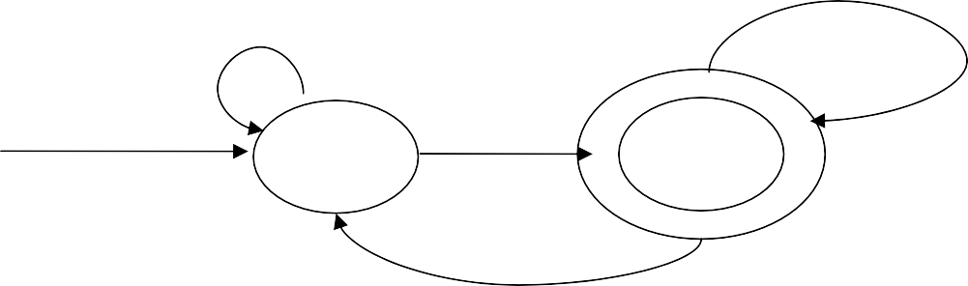
Compiler Construction
Lexical Analysis
Conversion from RE to DFA
Example1
For the RE --- ( a | b) * a #
1 2 3 4
followpos(1)={1,2,3},followpos(2)={1,2,3},followpos(3)={4},followpos(4)={}
S₁=firstpos(root)={1,2,3} mark S₁
for a: followpos(1) ∪ followpos(3)={1,2,3,4}=S₂ for b: followpos(2)={1,2,3}=S₁
mark S₂
for a: followpos(1) ∪ followpos(3)={1,2,3,4}=S₂ for b: followpos(2)={1,2,3}=S₁
b
a
move(S₁,a)=S₂ move(S₁,b)=S₁
move(S₂,a)=S₂ move(S₂,b)=S₁
a
start state: S₁
S₁
S₂
accepting states: {S₂}
b
45

Slide 55
Compiler Construction
Lexical Analysis
Conversion from RE to DFA
Example2
For RE---- ( a | ε) b c* #
1
followpos(1)={2}
2 3 4
followpos(2)={3,4} followpos(3)={3,4} followpos(4)={}
S₁=firstpos(root)={1,2} mark S₁
for a: followpos(1)={2}=S₂ for b: followpos(2)={3,4}=S₃ mark S₂
for b: followpos(2)={3,4}=S₃
mark S₃
for c: followpos(3)={3,4}=S₃
start state: S₁ accepting states: {S₃}
move(S₁,a)=S₂ move(S₁,b)=S₃
move(S₂,b)=S₃
S₂
b
a
move(S₃,c)=S₃
S₁
b
S₃
c
<number>

Slide 56
Compiler Construction Lexical Analysis
State Minimization in DFA
Partition the set of states into two groups:
G₁ : set of accepting states
G₂ : set of non-accepting states
For each new group G
partition G into subgroups such that states s₁ and s₂ are in the same group iff for all input symbols a, states s₁ and s₂ have transitions to states in the same group.
Start state of the minimized DFA is the group containing the start state of the original DFA.
Accepting states of the minimized DFA are the groups containing the accepting states of the original DFA.
<number>

Slide 57
Compiler Construction
Lexical Analysis
State Minimization in DFA
Example1
a
G₁ = {2}
G₂ = {1,3}
a
2
1
b
b
a
G₂ cannot be partitioned because
3
move(1,a)=2 move(3,a)=2
move(1,b)=3 move(2,b)=3
b
So, the minimized DFA (with minimum states)
b a
a
b
{1,3}
{2}
<number>

Slide 58
Compiler Construction
Lexical Analysis
State Minimization in DFA
Example2
Groups: {1,2,3} {4}
{1,2}
no more partitioning
a
a
2
a
1
b
4
b
a
{3}
a b
3
b
1->2
2->2
3->4
1->3
2->3
3->3
b
So, the minimized DFA
b
a
b
{3}
{1,2}
a
b
a
{4}
<number>

